Slide 1
HTML 5: Part I (Tags)

Slide 2
Outline
First Example
W3C Validation Service
Headings
Linking
Images
Special Characters and Horizontal rules
Lists
Tables
Forms
Internal Linking
Meta Elements

Slide 3
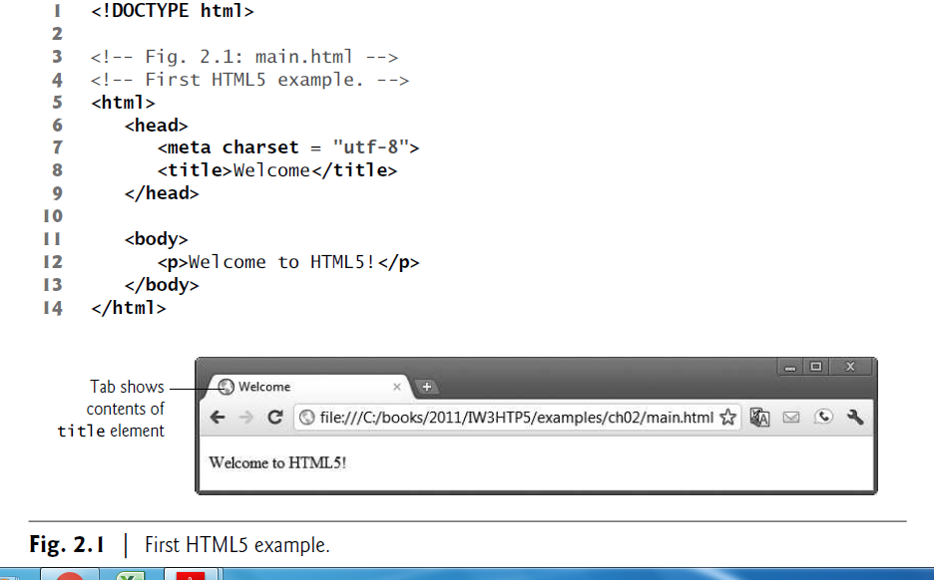
Structure of a Web Page

Slide 4
Document Type Declaration
The document type declaration (DOCTYPE) in line 1 is required in HTML5 documents so that browsers render the page in standards mode, according to the HTML and CSS specifications.
Blank Lines
We include blank lines (lines 2 and 10) to make our documents easier to read—the browser ignores them.
Comments
Lines 3–4 are HTML5 comments. You’ll insert comments in your HTML5 markup to improve readability and describe the content of a document.
The browser ignores comments when your document is rendered.
HTML5 comments start with <!-- and end with -->.

Slide 5
html, head and body Elements
HTML5 markup contains text (and images, graphics, animations, audios and videos) that represents the content of a document and elements that specify a document’s structure and meaning.
Start Tags and End Tags
HTML5 documents delimit most elements with a start tag and an end tag.
A start tag consists of the element name in angle brackets (for example, <html> in line 5).
An end tag consists of the element name preceded by a forward slash (/) in angle brackets (for example, </html> in line 14).
There are several so-called “void elements” that do not have end tags.

Slide 6
title Element
Line 8 specifies a title element. This is called a nested element, because it’s enclosed in the head element’s start and end tags.
The head element is also a nested element, because it’s enclosed in the html element’s start and end tags.
The title element describes the web page.
Titles usually appear in the title bar at the top of the browser window.
Paragraph Element (<p>...</p>)
Some elements, such as the paragraph element denoted with <p> and </p> in line 12, help define the structure of a document.
All the text placed between the <p> and </p> tags forms one paragraph.
When a browser renders a paragraph, it places extra space above and below the paragraph text.

Slide 7
W3C HTML5 Validation Service
You must use proper HTML5 syntax to ensure that browsers process your documents properly.
The World Wide Web Consortium (W3C) provides a validation service (validator.w3.org) for checking a document’s syntax.
Documents can be validated by
providing the URL of an online web page
uploading a file to the validator.
pasting code directly into a text area provided on the validator site

Slide 8
Headings
Some text in an HTML5 document may be more important than other text.
HTML5 provides six heading elements (h1 through h6) for specifying the relative importance of information
Heading element h1 is considered the most significant one and is typically rendered in a larger font than the other five.
Each successive heading element (h2, h3, etc.) is typically rendered in a progressively smaller font.

Slide 9
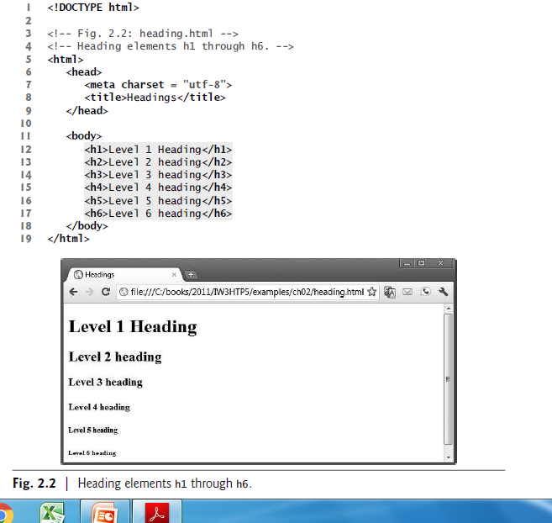

Slide 10
Linking
One of the most important HTML5 features is the hyperlink, which references (or links to) other resources, such as HTML5 documents and images.
When a user clicks a hyperlink, the browser tries to execute an action associated with it.
Any displayed element can act as a hyperlink. Web browsers
Typically underline text hyperlinks and color their text blue by default so that users can distinguish hyperlinks from plain text.

Slide 11
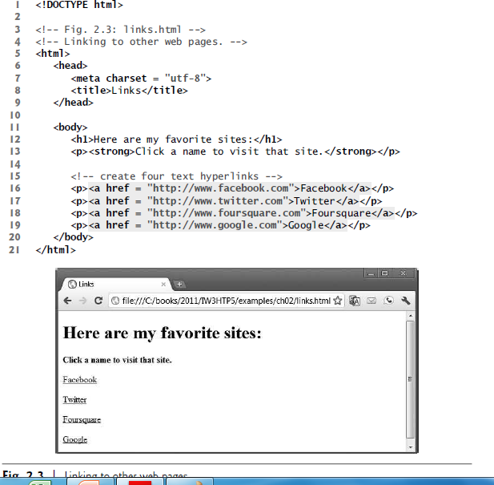

Slide 12
Links are created using the a (anchor) element. Line 16 defines a hyperlink to the URL assigned to attribute href (hypertext reference), which specifies a resource’s location, such as
a web page or location within a web page
A file
an e-mail address

Slide 13
Hyperlinking to an E-Mail Address
Anchors can link to e-mail addresses using a mailto: URL
When the user clicks this type of anchored link, most browsers launch the user’s default e-mail program (for example, Mozilla Thunderbird, Microsoft Outlook or Apple Mail) to enable the user to write an email message to the linked address.

Slide 14
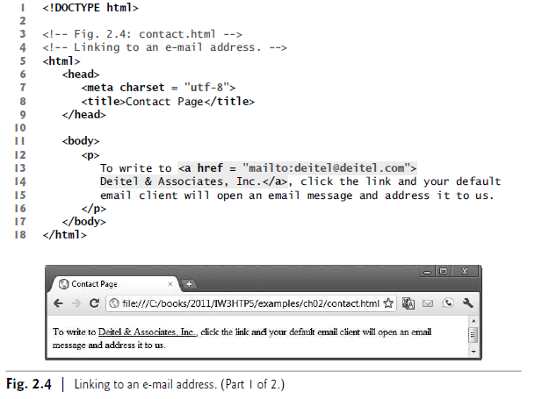

Slide 15
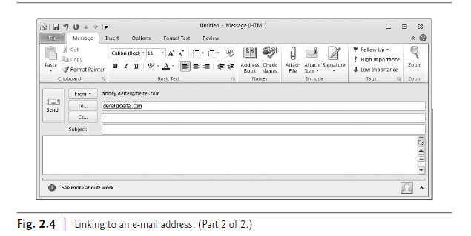

Slide 16
Images
We’ve shown how to mark up documents that contain only text, but web pages may also contain images, animations, graphics, audios and even videos.
The most popular image formats used by web developers today are
PNG (Portable Network Graphics) and
JPEG (Joint Photographic Experts Group).
Users can create images using specialized software, such as
Adobe Photoshop Express (www.photoshop.com),
G.I.M.P. (www.gimp.org),
Inkscape(www.inkscape.org) and many more

Slide 17
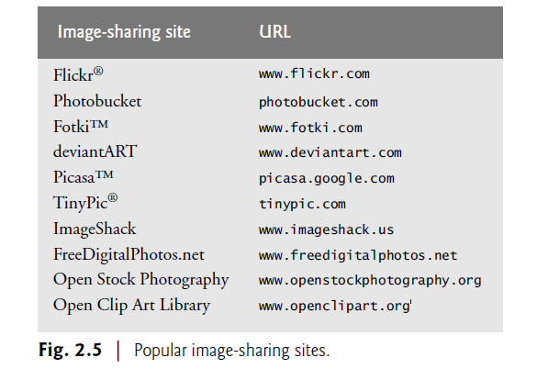
Images may also be acquired from various websites, many of which offer royalty-free images (Fig. 2.5)

Slide 18
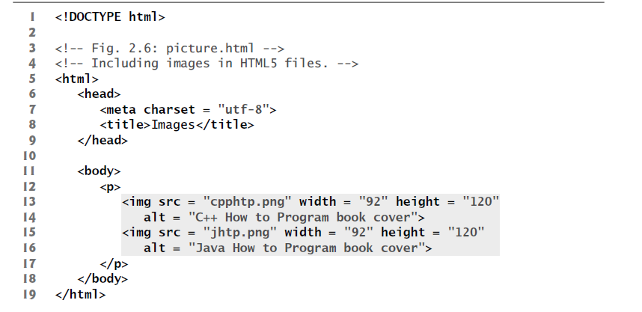

Slide 19
Using Images as Hyperlinks
By using images as hyperlinks, you can create graphical web pages that link to other resources.
In Fig. 2.7, we create five different image hyperlinks.
Clicking an image in this example takes the user to a corresponding web page—one of the other examples in this chapter.

Slide 20
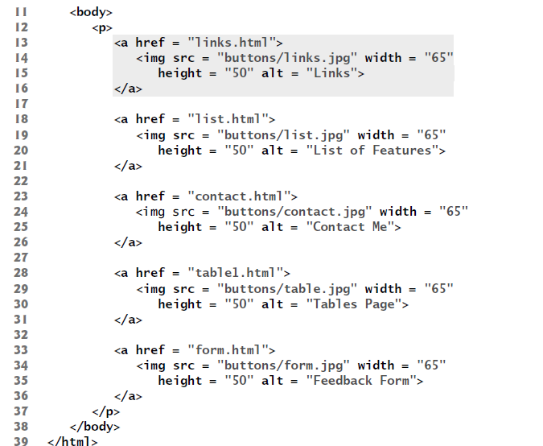

Slide 21
Lists
Different types of list tags in HTML are unordered list, ordered list and definition list.
Figure 2.10 displays text in an unordered list (i.e., a simple bullet-style list that does not order its items by letter or number).
The unordered-list element ul (lines 16–22) creates a list in which each item begins with a bullet symbol (typically a disc).
Each entry in an unordered list is an li (list item) element (lines 18–21).
Most web browsers render each li element on a new line with a bullet symbol indented from the beginning of the line.

Slide 22
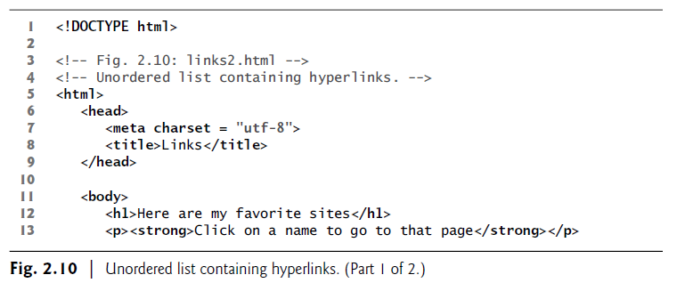
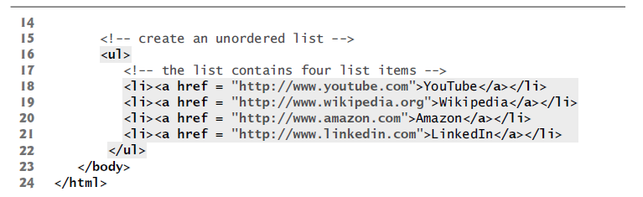

Slide 23
Nested Lists
Lists may be nested to represent hierarchical relationships, as in a multilevel outline.
Figure 2.11 demonstrates nested lists and ordered lists. The ordered-list element ol creates a list in which each item begins with a number.
In many browsers, the items in the outermost unordered list (lines 15–55) are preceded by discs.
List items nested inside the unordered list of line 15 are preceded in many browsers by hollow circular bullets.
A web browser indents each nested list to indicate a hierarchical relationship.
The first ordered list (lines 29–33) includes two items. Items in an ordered list are enumerated 1., 2., 3. and so on

Slide 24
<!DOCTYPE html>
<!-- Fig. 2.11: list.html → <!-- Nested lists and ordered lists. -->
<html>
<head>
<meta charset = "utf-8"> <title>Lists</title>
</head>
<body>
<h1>The Best Features of the Internet</h1>
<ul> <!-- create an unordered list -->
<li>You can meet new people from countries around the world.</li>
<li>You have access to new media as it becomes public:
<!-- this starts a nested unordered list, which uses a -->
<!-- different bullet. The list ends when you --> <!-- close the <ul> tag. -->
<ul>
<li>New games</li>
<li>New applications <!-- nested ordered list →

Slide 25
<ol>
<li>For business</li> <li>For pleasure</li>
</ol>
</li> <!-- ends line 27 new applications li-->
<li>Around the clock news</li>
<li>Search engines</li>
<li>Shopping</li>
<li>Programming <!-- another nested ordered list -->
<ol>
<li>XML</li> <li>Java</li> <li>HTML5</li> <li>JavaScript</li> <li>New languages</li>
</ol>
</li> <!-- ends programming li of line 38 -->
</ul> <!-- ends the nested list of line 24 -->
</li>
<li>Links</li>
<li>Keeping in touch with old friends</li>
<li>It's the technology of the future!</li>
</ul> <!-- ends the unordered list of line 15 -->
</body>
</html>

Slide 26
Tables
Tables are frequently used to organize data into rows and columns. Our first example(Fig. 2.12) creates a table with six rows and two columns to display price information for various fruits.
Tables are defined with the table element (lines 13–58). Line 13 specifies the table element’s start tag. The border attribute with the value "1" specifies that the browser should place borders around the table and the table’s cells.
The border attribute is a legacy attribute that you should avoid. When we introduce CSS3 (Chapter 4), we’ll use CSS’s border property, which is the preferred way to format a table’s borders

Slide 27
The caption element (lines 17–18) specifies a table’s title. Text in this element is typically rendered above the table.
In addition, it’s good practice to include a general description of a table’s information in the table element’s summary attribute—one of the many HTML5 features.
<!DOCTYPE html>
<!-- Fig. 2.12: table1.html -->
<!-- Creating a basic table. -->
<html>
<head>
<meta charset = "utf-8">
<title>A simple HTML5 table</title>
</head>

Slide 28
<!DOCTYPE html>
<html>
<head>
<meta charset = "utf-8"> <title>A simple HTML5 table</title>
</head>
<body> <!-- the <table> tag opens a table -->
<table border = "1">
<caption>
<strong>Table of Fruits (1st column) and
Their Prices (2nd column)</strong>
</caption>
<thead>
<tr> <th>Fruit</th> <th>Price</th> </tr>
</thead>
<tfoot>
<tr> <th>Total</th> <th>$3.75</th> </tr>
</tfoot>

Slide 29
<tbody>
<tr>
<td>Apple</td> <!-- insert a data cell -->
<td>$0.25</td>
</tr>
<tr>
<td>Orange</td>
<td>$0.50</td>
</tr>
<tr>
<td>Banana</td>
<td>$1.00</td>
</tr>
<tr>
<td>Pineapple</td>
<td>$2.00</td>
</tr>
</tbody>
</table>
</body>
</html>

Slide 30
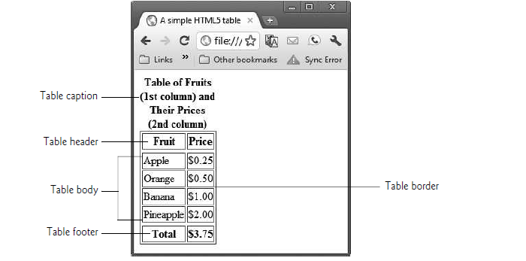

Slide 31
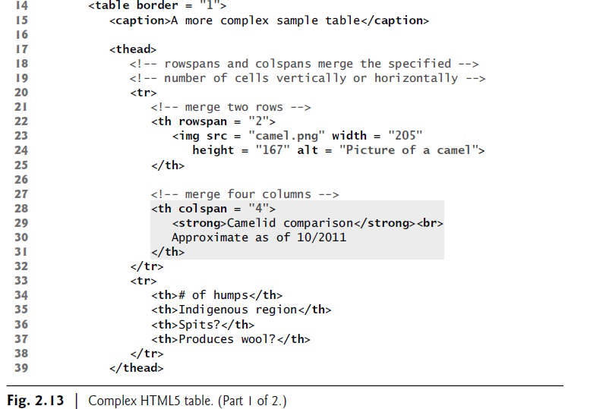
Using rowspan and colspan with Tables

Slide 32
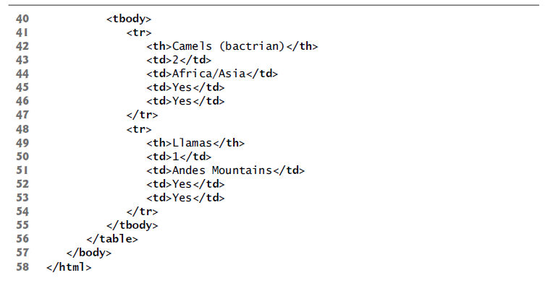

Slide 33
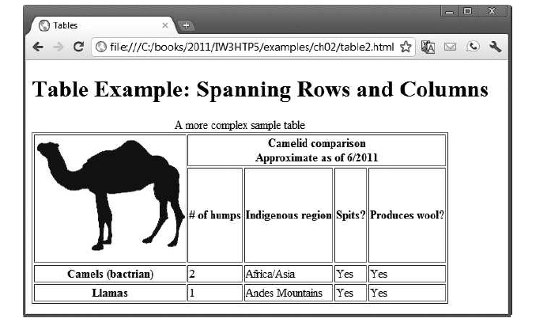

Slide 34
Forms
When browsing websites, users often need to provide information such as search queries, e-mail addresses and zip codes.
HTML5 provides a mechanism, called a form, for collecting data from a user.
Data that users enter on a web page is normally sent to a web server that provides access to a site’s resources (for example, HTML5 documents, images, animations, videos).
These resources are located either on the same machine as the web server or on a machine that the web server can access through the Internet

Slide 35
When a browser requests a publicly available web page or file that’s located on a server, the server processes the request and returns the requested resource.
A request contains the name and path of the desired resource and the protocol (method of communication).
HTML5 documents are requested and transferred via the Hypertext Transfer Protocol (HTTP).

Slide 36
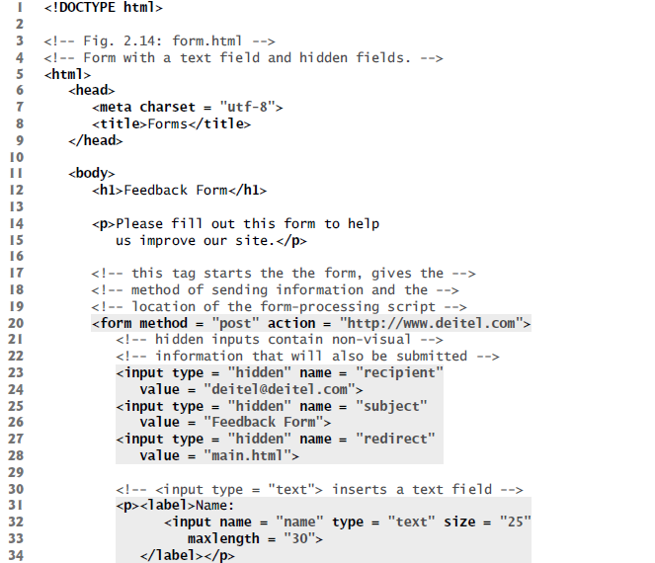

Slide 37
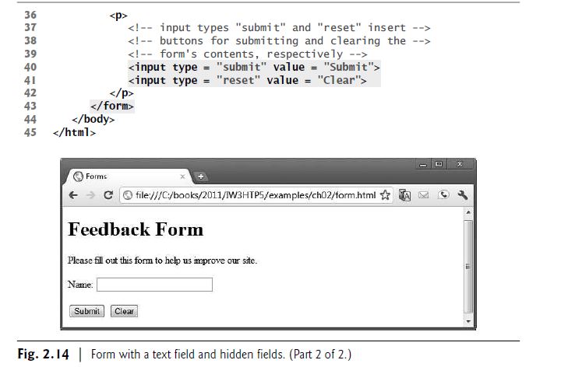

Slide 38
Internal Linking
Earlier in the chapter, we discussed how to hyperlink one web page to another.
Figure 2.16 introduces internal linking—a mechanism that enables the user to jump between locations in the same document.
Internal linking is useful for long documents that contain many sections.
Clicking an internal link enables the user to find a section without scrolling through the entire document.

Slide 39
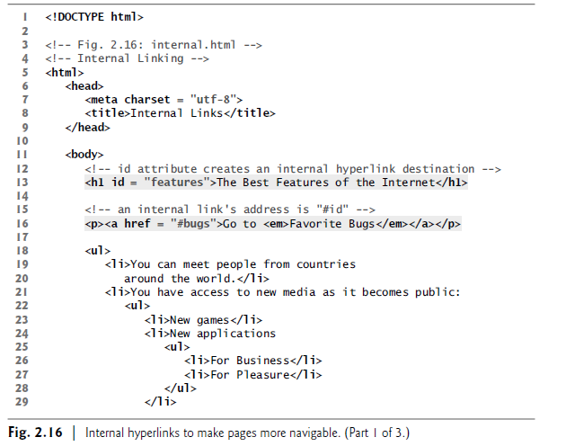

Slide 40
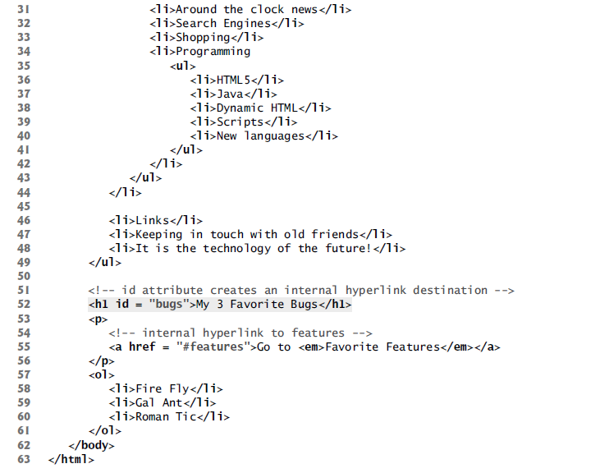

Slide 41
meta Elements
Search engines catalog sites by following links from page to page (often known as spidering or crawling the site) and saving identification and classification information for each page.
One way that search engines catalog pages is by reading the content in each page’s meta elements, which specify information about a document.
Using the meta element is one of many methods of search engine optimization (SEO)—the process of designing and tuning your website to maximize your findability and improve your rankings in organic (nonpaid) search engine results.
Two important attributes of the meta element are name, which identifies the type of meta element, and content, which provides the information search engines use to catalog pages.

